Slide 1
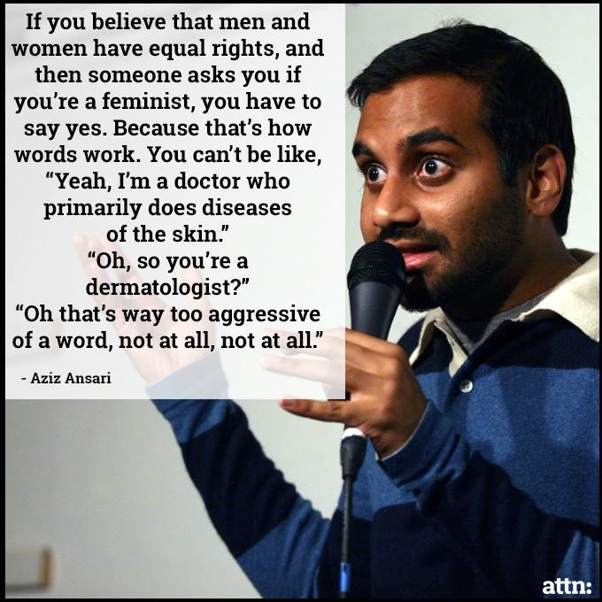
Twitter & Feminism
Pilot Study

Slide 2
What is a pilot study?
McLeod, S. A. (2007). Psychology Research Methods. Retrieved from http://www.simplypsychology.org/research-methods.html

Slide 3
Why Twitter?
Twitter is becoming a recognized and valid measure of the zeitgeist.
Twitter is being used to collect data by social scientists.
Using Twitter for Demographic and Social Science Research: Tools for Data Collection http://paa2013.princeton.edu/papers/130624
Viral marketing, memetic theory and the ability of small groups to control the space create new and more polarized dialogues.
Current debate on extremism — “The Counter Extremism Project welcomes press reports that Twitter Chief Executive Officer Dick Costolo has publicly acknowledged his platform’s failure to combat online abuse. This is clearly – even dangerously – overdue.” http://www.counterextremism.com/press/counter-extremism-project-calls-twitter-confront-all-abuse#sthash.bjDAXHzU.dpuf

Slide 4
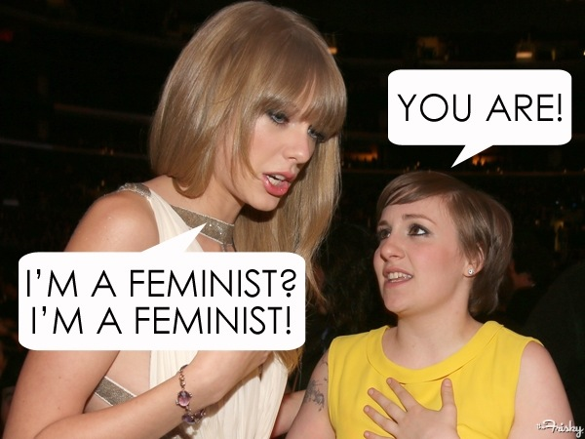
Why Feminism?
Renewed interest and dialogue on new media
Attention in traditional media, celebrities taking visible stances - 2014 as a bumper year for pop feminism, contraceptives, legal abortion, etc.
Potential backlash
Hunger Games and Frozen to 50 Shades of Grey and Meninism

Slide 5
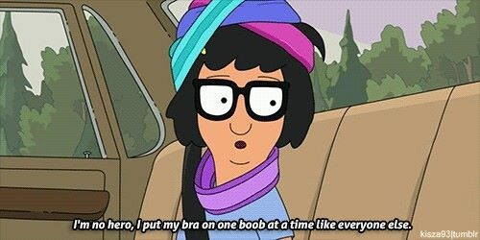
Current Feminism: A Refresher

Slide 6
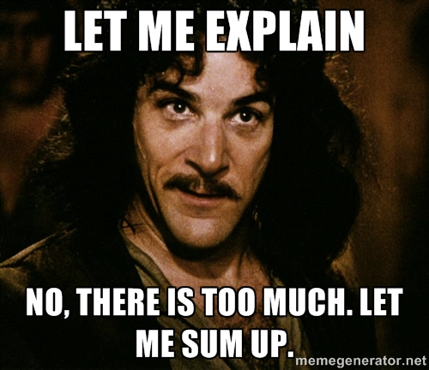
Feminism :
A Very Short History
First Wave: Women’s suffrage and basic political inequalities.
Second Wave: Mid-60s onward, social and cultural inequalities beyond basic political inequalities.
Third Wave: 90s and ongoing, focus on queer/trans/PoC and other diversity voices. Intersectionality, gender discrimination, and the normalization of BMO.

Slide 7
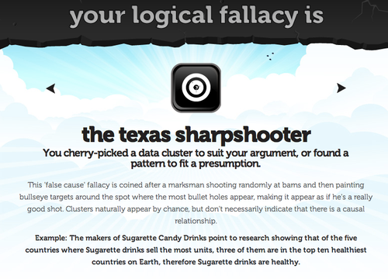
Feminism is having a fascinating moment and is noteworthily well documented via social media in a way that captures, more precisely and more accurately than before, the public opinion as it evolves on modern feminism.

Slide 8
Method
Participants: The people with public twitter feeds who tweeted, during the 7 random times of day I ran the code, with the word “feminist” or “feminism”.
Materials: The twitter API (accessed via Python and Tweepy) returns JSONs containing data about the tweet as well as the text of the tweet, which were then stored by MongoDB as BSONs.
An example datum: { "_id" : ObjectId(“54c6f420700d5a918cc47e0c"), "lang" : "en", "text" : "Why do people use the word feminist like it's a bad thing that irritates me so much", "fem" : 0 }

Slide 9
Method- Cont. : Procedure
Tweets captured by API at various times, to account for time of day bias in location. Only tweets in English.
Sub-section of random tweets hand-coded for valence:
0 : positive or neutral opinions on feminism
1: negative opinions of feminism or hate speech
Coded tweets used to train various machine learning model, and then test them. Models then extrapolated onto the much larger corpus of tweets to measure them for perceived valence on feminism.
Pros: Some context and humor controlled for by human coding
Cons: Time consuming, low context, uncaught irony

Slide 10
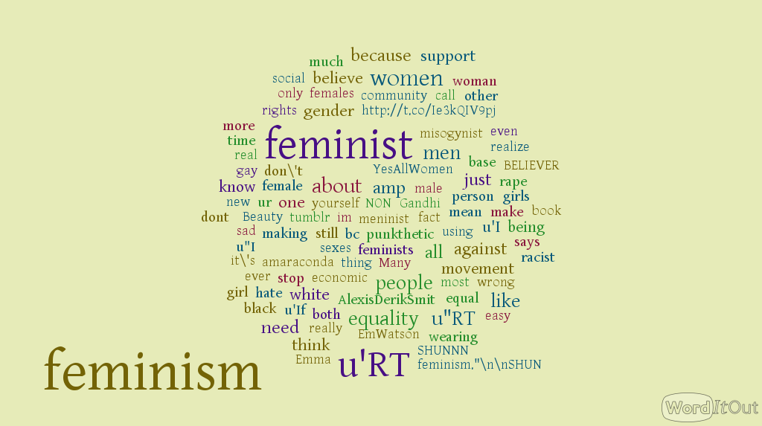
Word Cloud of Positive Tweets

Slide 11
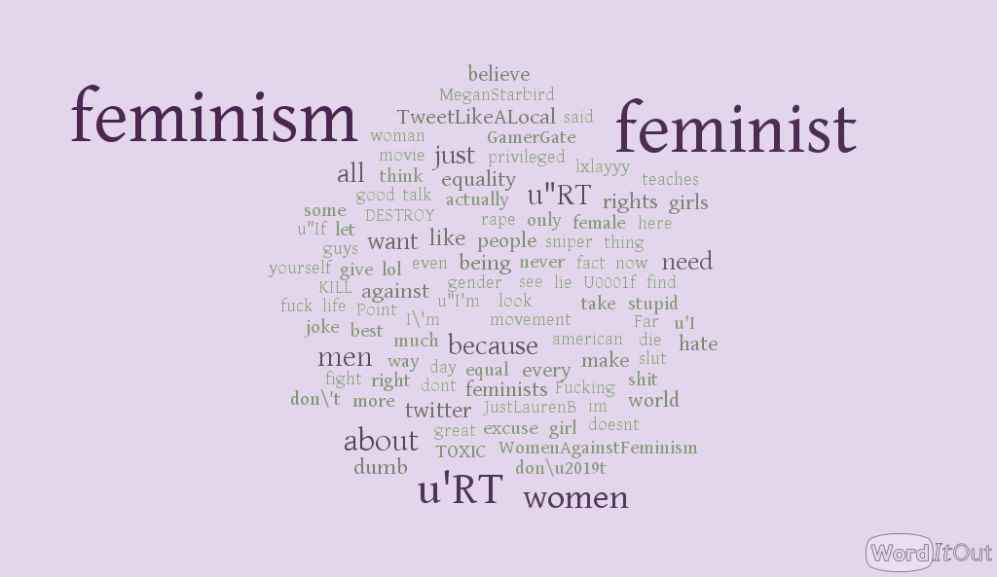
Word Cloud of Negative Tweets

Slide 12
Semi-Supervised Learning : Trained on codified subsample and used Multinomial Naive Bayes, Logistic Regression, Linear SVC and Bernoulli Naive Bayes in the sklearn library on the data.
Un-Supervised Learning:
Used gensim library to find most common tweets and construct a LDA model yielding 50 topics/clusterings within the data.
Used sklearn MiniBatchKMeans to cluster data into 10 main groups.
Used textstat to determine grade level of average negative or positive tweet.

Slide 13
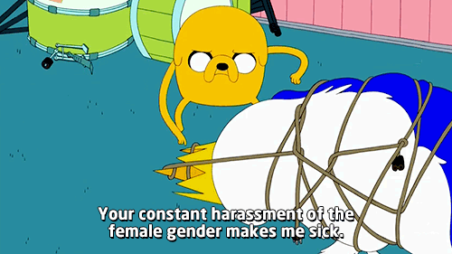
Results: Semi-Supervised
Twitter Doesn’t Love Feminism
Most Accurate models:
Linear SVC models Twitter as 52% negative on feminism
Logistic Regression models Twitter as 54% negative on feminism

Slide 14
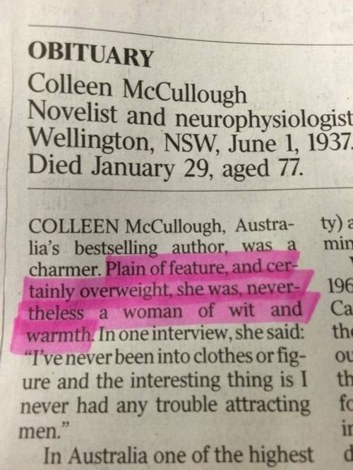
Results: Unsupervised Learning
Most retweeted tweets:
RT @MeninistTweet: Today, a feminist asked me how I view lesbian relationships... Apparently "in HD" was not the right answer
RT @vanbadham: Why feminism? Because you can sell 30 MILLION copies of a single book and when you die, The Australian prints this: ->
RT @vanbadham: Why feminism? Because she was ALSO a FREAKIN' NEUROPHYSICIST at YALE & this is how The Australian begins her obituary
RT @JessicaKRoy: finally a feminist snowstorm
RT @hayleyestxlle: Feminism has never made me hate men but men's reaction to feminism definitely has.
RT @TheBlackVoice: It's amazing how threatened men are by the term feminist while not even being able to provide a working definition
T @clementine_ford: I keep hearing that feminism is bad for women, and I think what that's supposed mean is that feminism is bad for men

Slide 15
Women Against Feminism

Slide 16
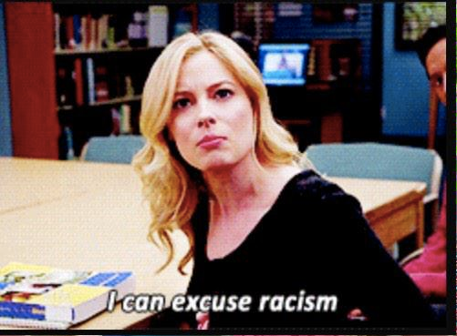
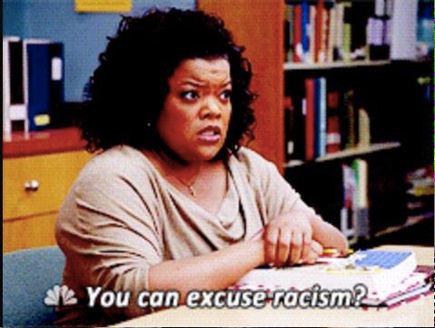
Main Clusters/MiniBatchKMeans
White feminism and intersectionality ->
Feminism isn’t necessary
“ellekersten because theres a difference between a women who is a feminist and a women who wants equal rights feminist are crazy”
General shaming, profanity and MRA
'do not rape a feminist it would fulfill her hot rape fantasies and let us be honest what kind of animal would want to make a feminist happy’
New Feminism
'disturbedfan132 i believe myself to be a feminist and tho i disagree with the new femfad they sometimes make points’
Feminists hate men
‘rt lxlayyy being a feminist doesnt give you the right to talk bad about guys’
Feminism is still needed
'people who say we dont need feminism and everyone is already equal clearly arent aware of whats going on around the world’
Feminism and new media
‘i have never said i was feminist bc i dont want all of you dragging me saying im only feminist on twitter or tumblr’

Slide 17
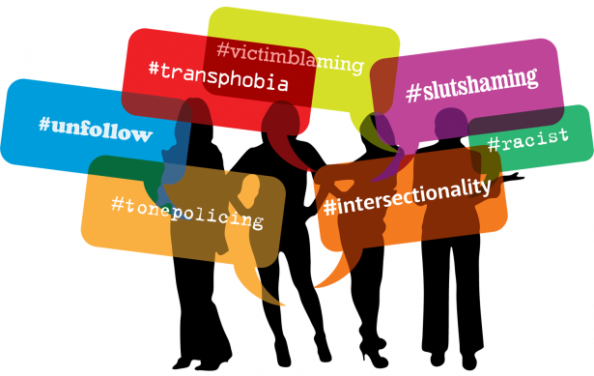
Smaller Clusters/LDA
Humor as Defense? u, jokes, r, it's, don't, joke!, seriously!, toxic!!, haha!
Intersectionality? never, one, make, women, misconceptions, base, movement, black, people, feminist/misandriuc,, non-feminists, poster, posters
@NoToFeminism women, teaches, stupid, lol, entice, enthrall, enchant,and, berate, nag,, tradition, demand, how's, freeing,
YesAllWomen: it's, women, equal, incomprehensibly, and, still, acknowledge, #ineedfeminismbecause, @prowomanchoice, men, #yesallwomen, 2015, want, tube
Witchcraft?kill, woman, husbands, witchcraft,, encorauges, lesbianism, children, capitalism, practice, destroy, leave, become, movement, need
Media Response: forced, chapter, perspectives, normal, man's, cuoco, kaley, apologize, respects, interesting, cissexist, ('females'), extending, simplistic
Trendy Feminism: equality, support, gender, believe, women, want, tumblr,, aspe…, "trendy"
Intersectionality: white, room, appropriation, responds,feminist™, cultures, obligation, claiming, racist
Media Representation: people, annoying, "hollywood's, year", languages, #girlsmatter, silent?, acculturated
Anti-Feminist Pro-Equality Paradox:≠, calling, making, women, i, theory, #equalist, @victorialwalton, #stoptheimmaturity, #misandrist, #letsbereal

Slide 18
“Can we have ONE conversation about feminism where men get to be in charge?”

Slide 19
Discussion
Grade level of negative tweets consistently measured as at least a grade level below neutral/pro-feminist tweets
Higher levels of profanity and misspelling in negative tweets

Slide 20
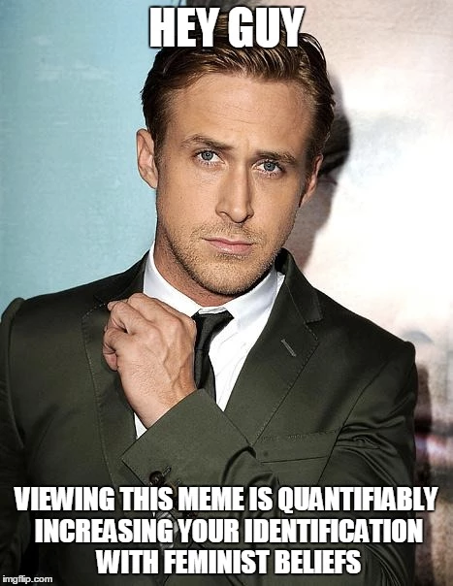
Improvements Required to Progress Beyond Pilot
Constrained by small codified samples and the need to have both test and train sub-sets, accuracy could be improved by increasing number of codified tweets, ideally codified by multiple people to control for individual bias.
Sample size is 217 negative and 217 positive tweets to 30k uncoded tweets
Goal: Have the script running constantly to display a stock market value of feminism on Twitter and how real time events affect it.
Be able to monitor twitter-verse for how events impact the public’s view on feminism, what causes backlashes, measure impact of Beyonce, etc

